Slide 1
Scripting Languages
Module 5
Regular Expressions, Redirection, Piping and Grep

Slide 2
Contents
Regular Expressions
Regular Expression Engines
Grep and Regex
Anchors and Wildcards
Extended RegEx Engine
ERE Repetition and Optionality
OR and Expression Grouping
Common Grep Options
Piping and Redirection

Slide 3
Learning Objectives
After completing this module, you should be able to work with:
Regular Expressions
Regular Expression Engines
Grep and Regex
Anchors and Wildcards
Extended RegEx Engine
ERE Repetition and Optionality
OR and Expression Grouping
Common Grep Options
Piping and Redirection

Slide 4


Regular Expressions

Slide 5
Regular Expressions
Regular Expressions, more commonly referred to as regex, are used to match patterns in text
A regex text pattern is provided to a regex engine to allow it to find a match
Once a match is found, other commands and utilities can then be called upon to interact with the matched data in some way

Slide 6
Regex engines
There are two regular expression engines supported by bash commands
Basic Regular Expression Engine (BRE)
Extended Regular Expression Engine (ERE)
These are supported by several commands and utilities, in particular grep, sed and awk
BRE and ERE are also regularly used for data validation purposes as well
The remainder of this module will examine regex as used with grep

Slide 7
grep

Slide 8
What is grep?
grep stands for Global Regular Expression Print
grep searches through stipulated input files for lines containing a match to a regex pattern
When a match is found in a line, grep copies the line to standard output by default, or another output if stipulated by options or piping
grep is highly integrated with BRE and ERE to perform the tasks it is designed to do

Slide 9
grep and regex

Slide 10
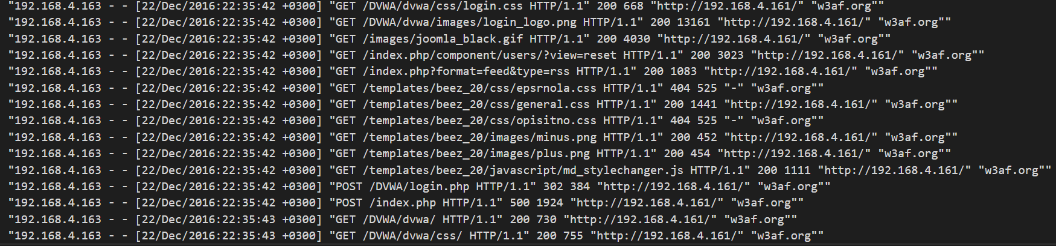
Sample Data Set
The following grep and regex examples are based on an access log data set acquired from https://github.com/ocatak/apache-http-logs/blob/master/w3af.txt (06/07/2020)

Slide 11
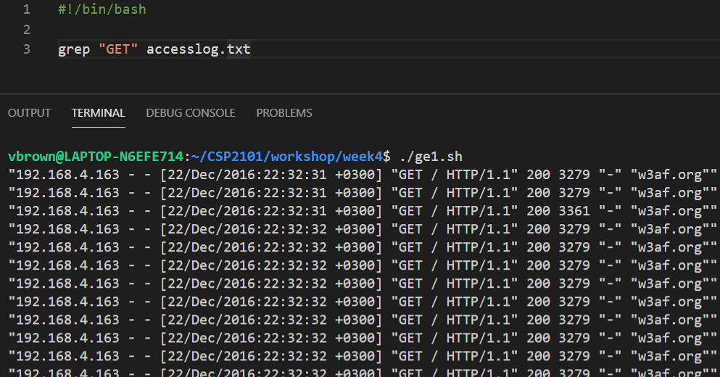
Simple BRE matching
Command
RegEx
Source
~/CSI6203
Output

Slide 12
Anchors and Wildcards

Slide 13
Anchor characters
Regex patterns can use special characters called anchor points to represent specific locations within the text
The two most common anchor points are
The start of the line ‘^’ (The ^ symbol is the circum accent, or circum for short)
The end of the line ‘$’

Slide 14
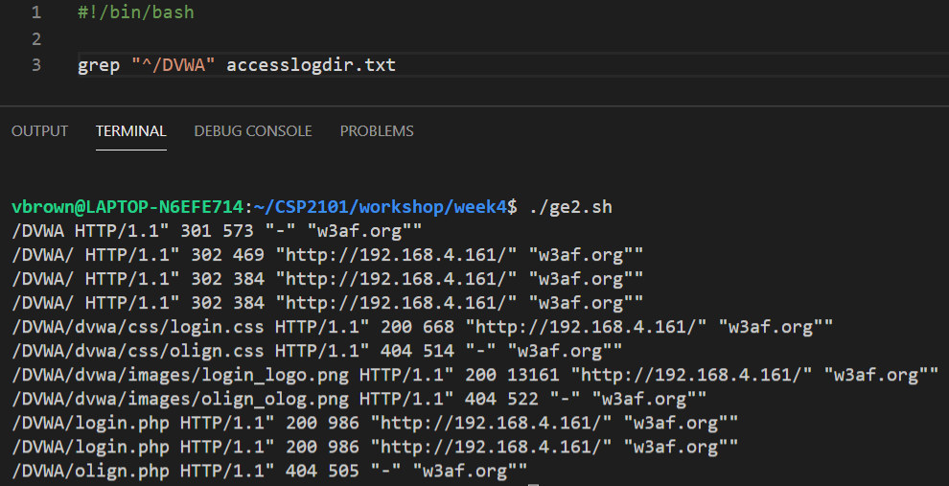
Start of line anchor ^
start of line (circum) anchor
~/CSI6203
Output

Slide 15
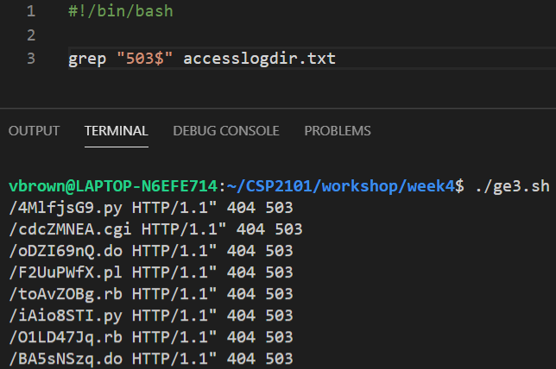
End of line anchor $
end of line ($) anchor
~/CSI6203
Output

Slide 16

Wildcard characters
Wildcards are characters that could match a range of characters
In regex, the most common wildcard is dot ‘.’
The dot character can be used to represent any character, e.g. find lines that start with a string ending in an
1
2
3
4
Make match case insensitive
Must occur at start of line
Any character acceptable
String must end in an

Slide 17
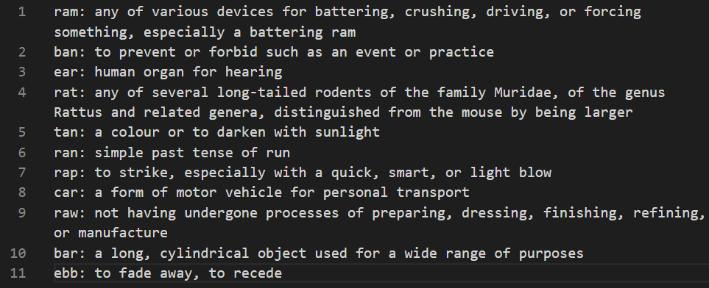
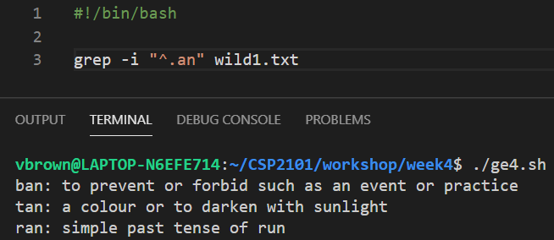
Wildcard characters
~/CSI6203

Slide 18
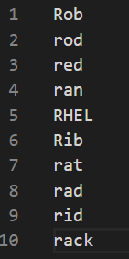
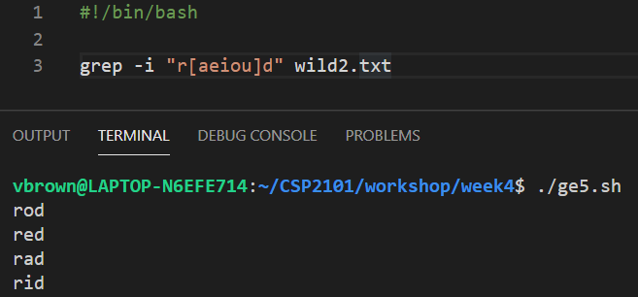
Classed wildcards
Square brackets [ ] are used to restrict a wildcard to be only one of a set of values
In this example, find lines contain a string starting with R/r followed by any single instance of a vowel and ending with d
1
2
3
4
~/CSI6203
Make match case insensitive
String must start with R/r
Followed by any single vowel instance
String must end in a d

Slide 19
Specify allowable range with [ ]
Square brackets [ ] can also specify a range of allowable potential characters
A string example would be grep “[A-Z]” text.txt, i.e look for lines that contain capital letters from A to Z inclusive
A numeric example would be grep “[0-9]” text.txt, i.e look for lines that contain a number

Slide 20
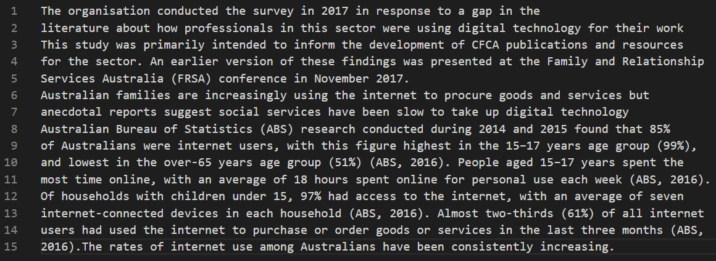
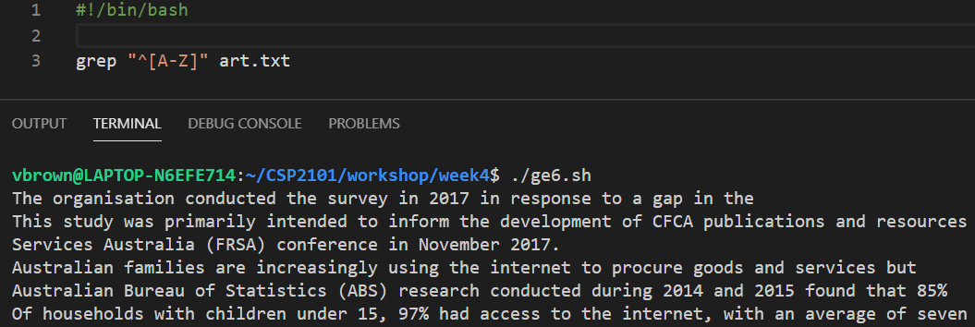
[ ] example - string
Find all lines that start with a capital letter between A and Z inclusive
~/CSI6203

Slide 21
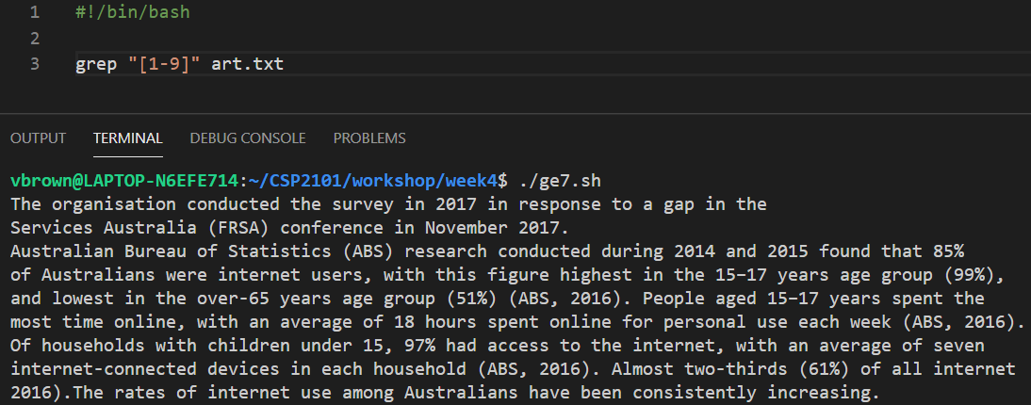
[ ] example - numeric
Find all lines that a number
~/CSI6203

Slide 22
Extended RegEx Engine

Slide 23
Extended Regex
ERE can also match with several other collections of classes
Pattern | Effect
[[:alpha:]] | Alphabetical character A-z, a-z
[[:alnum:]] | Alphanumeric character A-z, a-z, 0-9
[[:digit:]] | Digit 0-9
[[:upper:]] | Uppercase A-Z
[[:lower:]] | Lowercase a-z
[[:space:]] | Any whitespace character (space tab newline)
[[:blank:]] | Space or tab
[[:punct:]] | Punctuation character e.g. “!,.;”

Slide 24
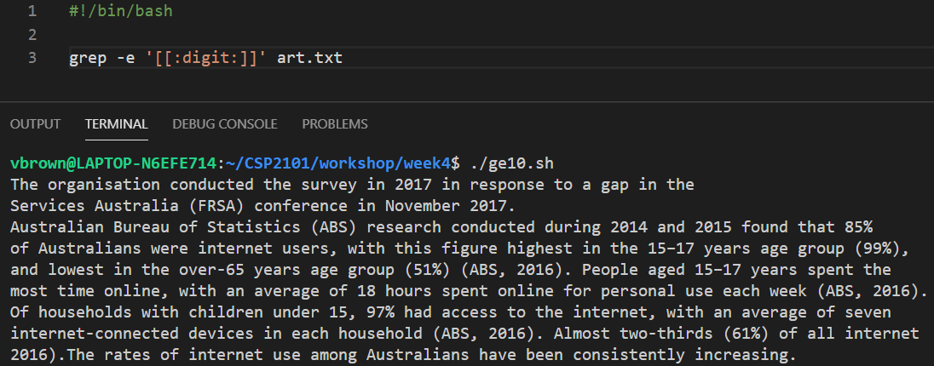
Example ERE class - [[:digit:]]
~/CSI6203

Slide 25
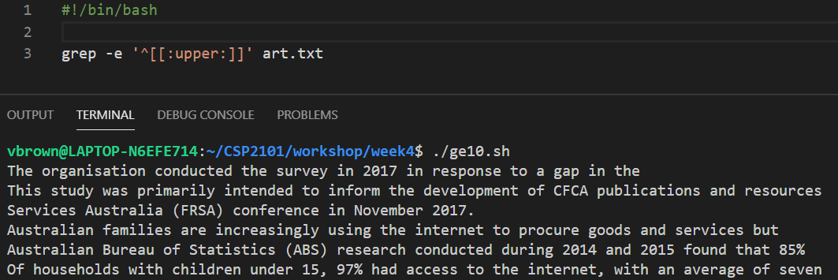
Example ERE class - [[:upper:]]
~/CSI6203

Slide 26
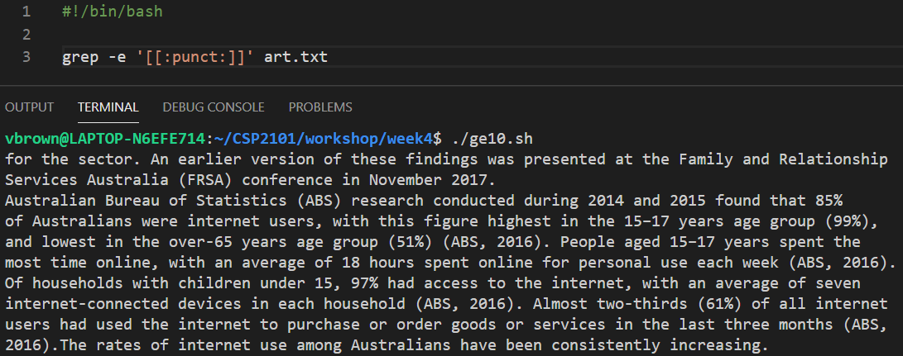
Example ERE class - [[:punct:]]
~/CSI6203

Slide 27
ERE Repetition and Optionality

Slide 28

The Asterisk Wildcard
In regex, the asterisk can be used to repeat the previous part of the pattern 0 or more times
For example, the grep regex on the right Would find the strings yes, yees and yeees

Slide 29

The Asterisk Wildcard
The asterisk wildcard can also be used with other regex characters too
For example, the grep pattern search to the right would find the strings yes, yees, yas and yaas

Slide 30
ERE
In the ERE syntax, there are even more useful and versatile pattern matching operators including:
• +
?
{}
|
()

Slide 31

ERE Plus +
The Plus character “+” acts similarly to the asterisk “*” except instead of 0 or more repetitions, there must be at least one or more repetitions
For example, the grep pattern search to the right would return the strings yes, yees, yas and yaas, but not ys
\+s’

Slide 32

Question Mark ?
The question mark character “?” acts as an optionality operator, meaning that the preceding character may or may not be present in the pattern being sought
For example, the grep search to the right would find both bash and ash

Slide 33

Curly Braces { }
Braces { } are used to specify a specific number of repetitions of a character or sequence
For example, the grep pattern search to the right will return Robert, Rabbit and Rupert, but not Rivet

Slide 34
OR and Expression Grouping

Slide 35
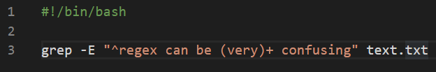
Expression Grouping
Using parentheses ( ) regex patterns can be grouped together to allow for more complex search patterns to be constructed
In the example below, (very) must be present positionally at least once and the + indicates what follows must also be positionally present
Note: grep -E escapes traditional usage of special characters. For example, the command grep -E '{1' searches for the two-character string {1 instead of reporting a syntax error in the regular expression

Slide 36
Expression Grouping
Potential Matches:
regex can be very confusing
regex can be very very confusing
regex can be very very very very confusing

Slide 37

OR |
In bash, the pipe operator “|” is usually used to redirecting the output of one script or command to the input of another
Within the context of a regular expression however, it takes on the functionality of or
For example, in the grep pattern search to the right, lines will be returned that end with either the string bash or the string fish

Slide 38
grep options

Slide 39
Common grep options
Option | Description
-c | Suppress normal output; instead print a count of matching lines for each input file
-E | Interpret PATTERN as an extended regular expression.
-i | Ignore case distinctions in both the PATTERN and the input files.
-m NUM | Stop reading a file after NUM matching lines.
-n | Prefix each line of output with the line number within its input file.
-o | Show only the part of a matching line that matches PATTERN.
-v | Invert the sense of matching, to select non-matching lines
-w | Select only those lines containing matches that form whole words

Slide 40
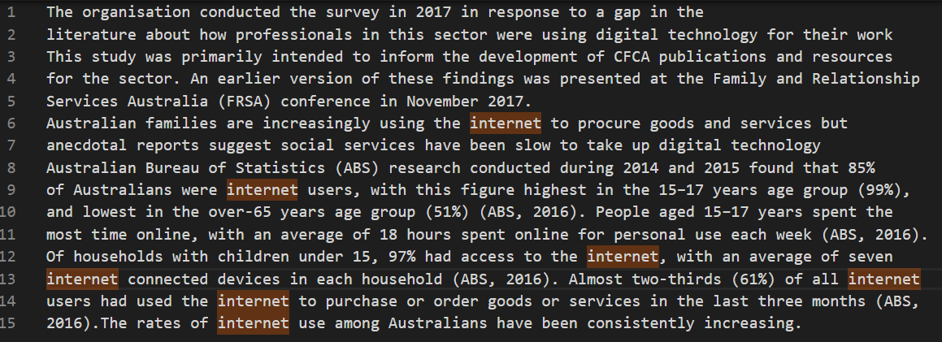
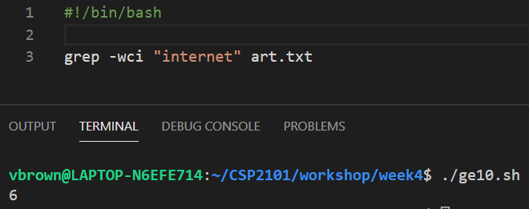
grep Options Example
Make case insensitive
Whole word matches only
Count matching lines
~/CSI6203

Slide 41
Piping and Redirection

Slide 42
Redirection
Bash Data Streams
As discussed in Module 2, bash commands and utilities have automatic access to three (3) data streams:
STDIN (0) - Standard Input, this is the stream that feeds data into a command or utility
STDOUT (1) - Standard Output, this is the stream that outputs data from the command or utility; the terminal by default
STDERR (2) - Standard Error, this is for error messages; also defaults to the terminal)
STDIN (0)
COMMAND / UTILITY
STDOUT (1)
STDERR (2)

Slide 43
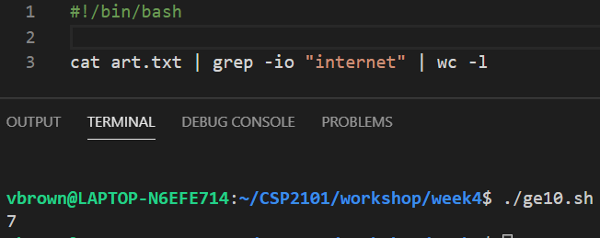
Redirection
Bash Data Streams
Bash pipes and redirection allows streams between command, utilities and files to be connected in specific sequence to manipulate data in useful and flexible ways
In the example below, three (3) commands are used to count the number of instances of a whole string in a file

Slide 44
Redirection
Example Deconstructed
1 | The cat command makes a copy of the file named art.txt
2 | Pipes the data acquired by cat to the STDIN of the next command (grep)
3 | The grep command retrieves lines of data it receives for each instance of the whole string internet in a case-insensitive mode
4 | Pipes the data acquired by grep to the STDIN of the next command (Word Count)
5 | The Word Count command will count all instances of the string internet in the data received line by line
1
2
3
4
5
~/CSI6203

Slide 45
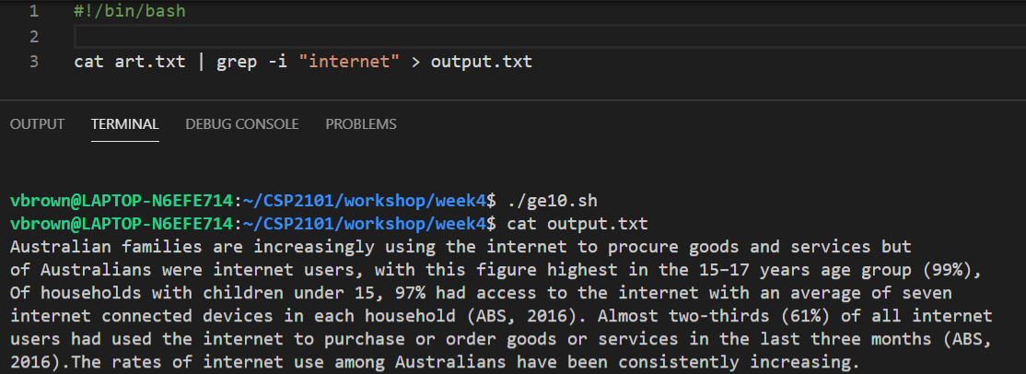
Redirection
Redirection
The standard input and standard output can be redirected to use files instead using the redirection operators < and >
EXAMPLE 1
Output the results produced by cat and grep to a file named output.txt. If the file does not exist, it will be created.
~/CSI6203
~/CSI6203

Slide 46
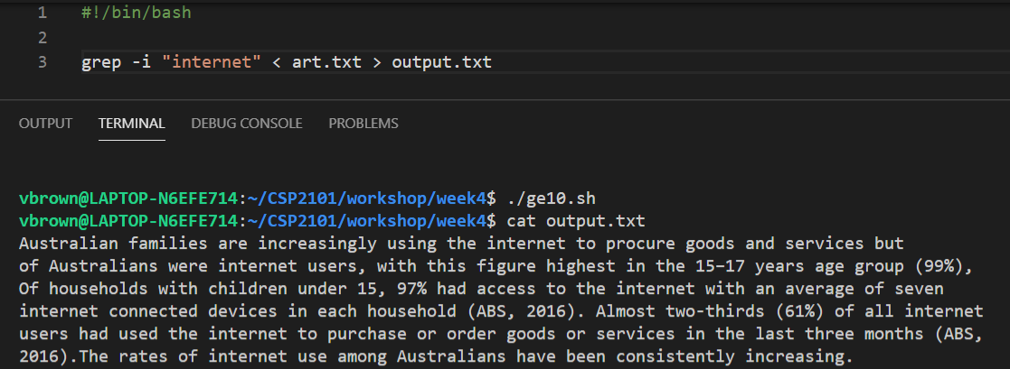
Redirection
Redirection Example 2
Output the processed data from grep to a file named output.txt. If the file does nor exist, create it.
Input the data that grep is to operate on from the file named art.txt.
~/CSI6203
~/CSI6203

Slide 47
Summary
Terms to Know
Regular Expressions
Regular Expression Engines
Grep and Regex
Anchors and Wildcards
Extended RegEx Engine
ERE Repetition and Optionality
OR and Expression Grouping
Common Grep Options
Piping and Redirection

Slide 48
References and Further Reading
Ebrahim, M. & Mallet, A. (2018). Mastering Linux Based Scripting (2nd Ed), Chapter 11, pp 194-215.
http://regular-expressions.info/engine.html
http://tldp.org/LDP/Bash-Beginners-Guide/html/chap_04.html
https://regexr.com/
https://regex101.com/

